Slide 1
IDC’s IT Executive Programs
Digitally Transforming Business
to the 3rd Platform

Slide 2




IDC Latin America’s Competitive Advantage
IDC is the main provider of market intelligence, advisory and events services for the Latin American ICT industry.
We provide accurate insights and unbiased influence for ICT buying and selling decisions.
Presence
Accuracy
Opinion Leadership
Zealous
Customer Service
+25 years of detailed market sizing and forecasting services for major countries in Latin America
110 analysts covering more than 50 countries and 100+ markets in the ICT industry every quarter
Consistent methodologies across global markets to allow valid comparisons across countries, regions or the world
Broad and deep coverage of thousands of direct sources in countries of Latin America feed a best-in-class Big Data engine
Years of experience curating information and pioneering data science
Highest analyst to client ratio in the industry
Most respected, frequently quoted source of global market intelligence
First to market identifying disruptions: 3rd Platform; Digital Transformation (DX); IT 3D Leadership
Flexible support model, and customer service
Dedicated experts that sit on the research side of IDC, directly supporting our key clients
Analysts and sales partners who know your business objectives

Slide 3
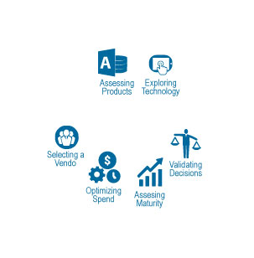



How well are you transforming your IT organization to drive business growth?
The fundamental role of technology is evolving and with it, every dimension of the business.
Business leaders need a better compass for technology buying decisions.
45%
of IT executives feel they are behind their peers in innovation
25%
of 3rd Platform initiatives are struggling
45%
of IT organizations are not effectively engaging with business leaders

Slide 4

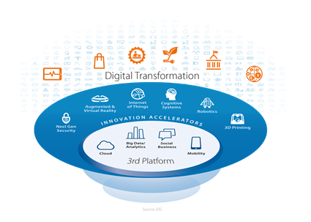

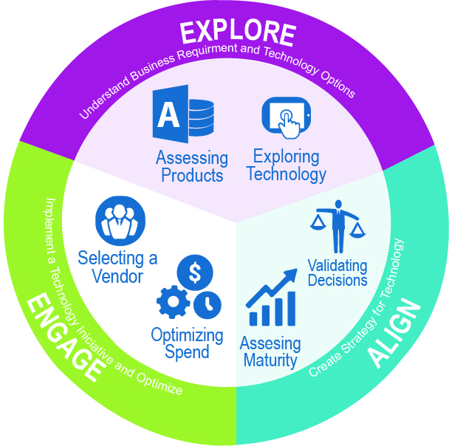
IDC’s IT Executive Programs (IEP)
The ABC’s of Partnering with IDC
IDC’s IT Executive Programs consist of a family of research programs intended to help today’s time constrained technology professionals and influencers make more effective technology decisions.
A
B
C
Expert Analysts
Broad Base of Research
Concierge Customer Service
Do you need:
to identify emerging technologies and vendors?
to learn peer practices?
to understand future, industry and tech trends?
to have inquiry calls (not limited to 30 minutes) and bring your full team?
to validate decisions with experts/thought leaders in the industry?
If you answered yes to any of these questions, you need to be part of the IDC’s IT Executive Program (IEP)

Slide 5
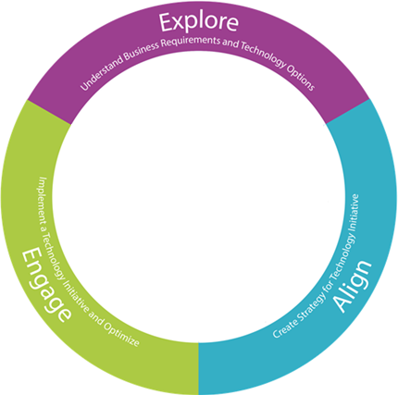






By topic in the Digital and Enterprise IT Transformation
A
Expert Analysis
A
B
C
Analyst Team (in local language): Supported by global analyst team with local insight.
Expert Analysts
Broad Base of Research
Concierge Customer Service
IDC’s Insights Lines of Business help you drive industry innovation
Leadership Transformation
IT Strategy and Governance
Innovation Strategies
Omni-Experience Transformation
Customer Experience
Devices: PCs, Mobility, AR/VR & Wearables
Information Transformation
Enterprise/ NexGen Security
WorkSource Transformation
Leadership in 3D
Strategic Architecture
Services Transformation
Device/Mobility Strategies
Social Business
eCommerce
Enterprise Applications
Data Management
Big Data & Analytics
Cognitive Computing
Operating Model Transformation
Enterprise Infrastructure
AppDev & App Provisioning
DevOps
Cloud Strategies
Transformative Tech: IoT, 3D Print & Robotics
Vendor Sourcing & Management
IT Talent & Skills Management
Outsourcing/ Services Provisioning
IT Organizational Development
Technology Training
By Industry

Slide 6
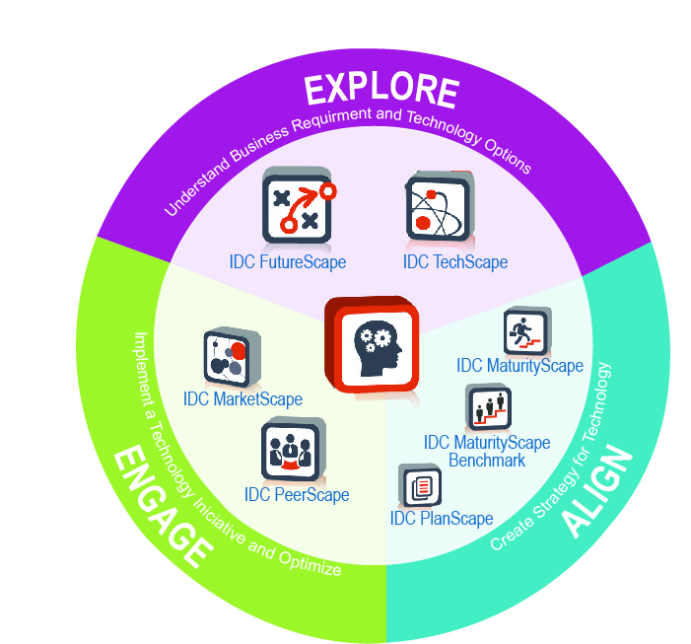
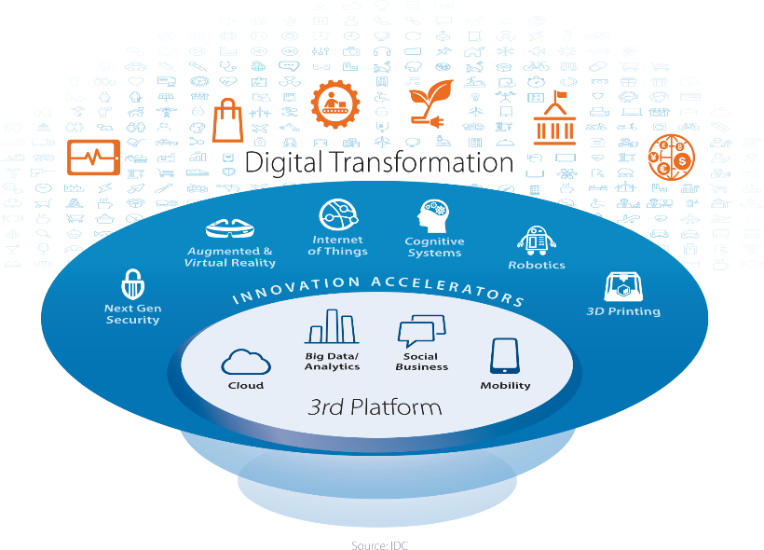
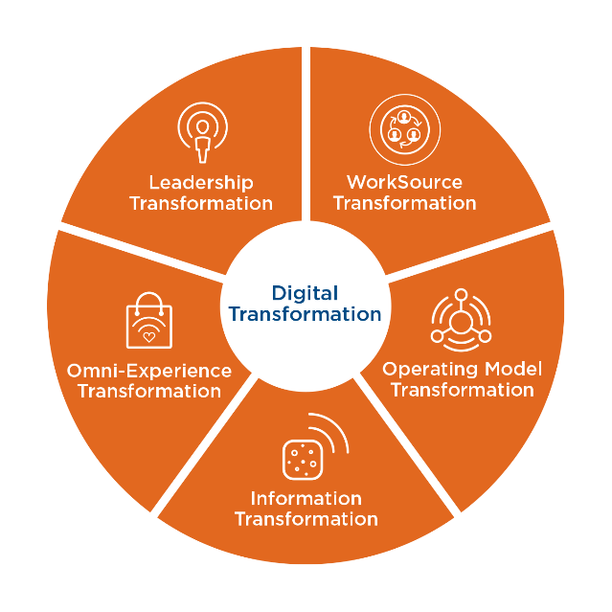
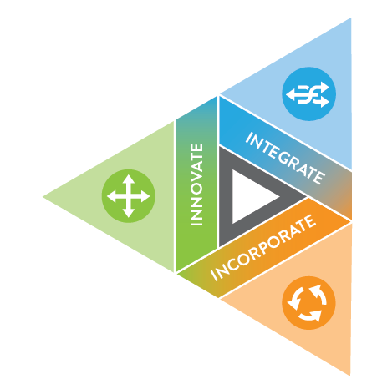
To transform IT is to transform the Business
B
Broad Base of Research
A
B
C
Industry specific expertise: industry analysts with combined decades of industry experience
Expert Analysts
Broad Base of Research
Concierge Customer Service
IDC DecisionScapes drive better technology decisions and ensure the maximum business impact.
3rd Platform
Digital Transformation
Leading in 3D
Technology is the Underpinning of DX
Transformation of the Business
The IT Organization Needs to Transform First

Slide 7
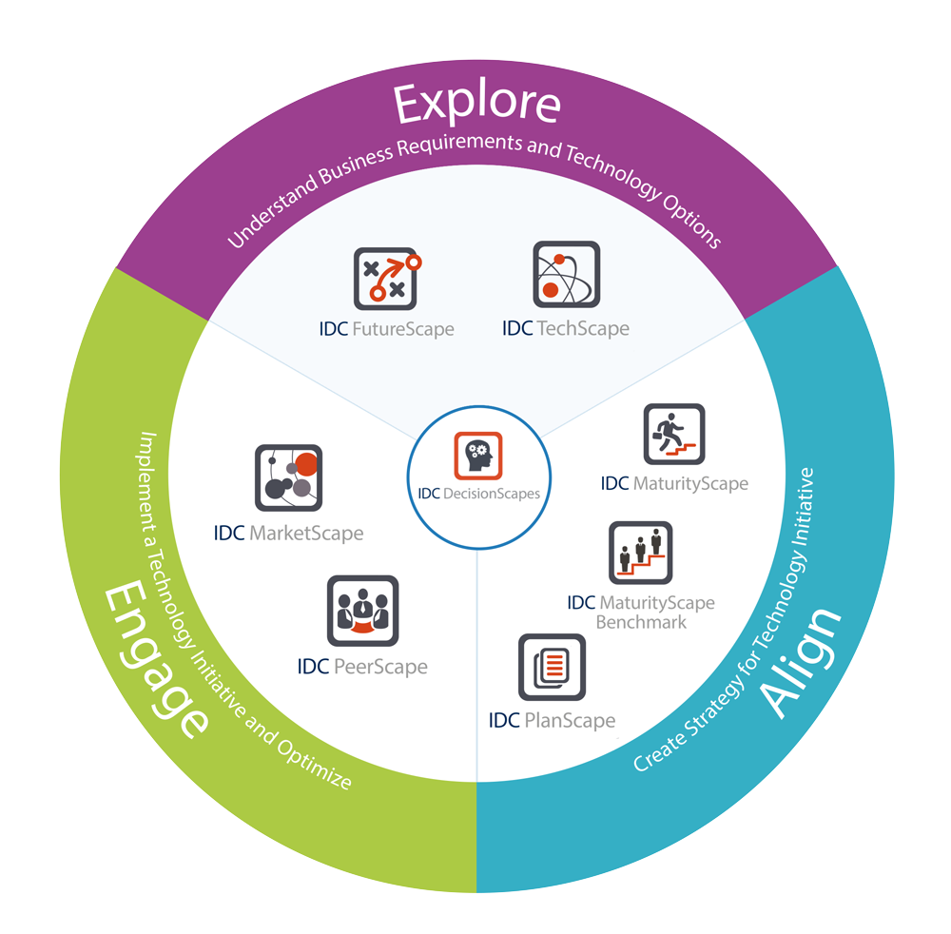
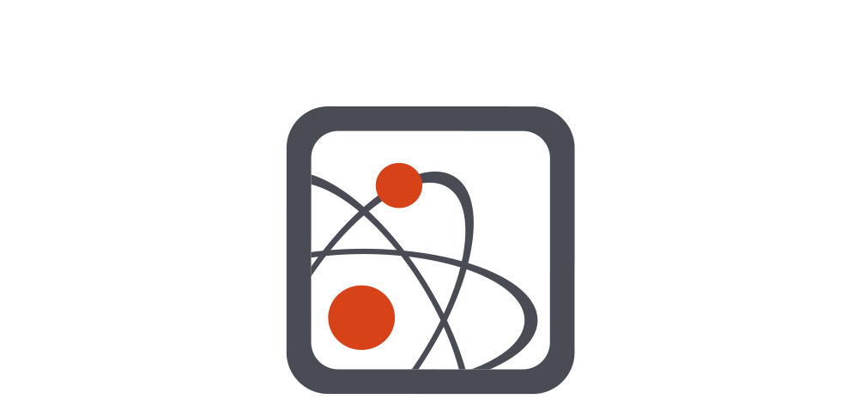
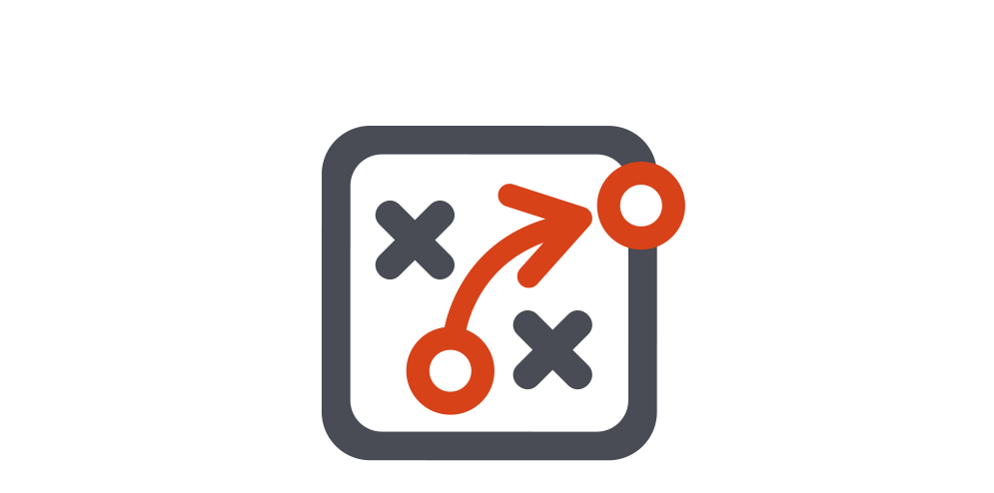
Explore: Understand Business Requirements and Technology Options
IDC TechScape mitigates technology
risk by helping organizations align their tolerance for risk with the anticipated maturation of a technology.
IDC FutureScape is used to shape IT strategy and planning by providing a framework for evaluating IT initiatives in terms of their value to business strategy now, and in the future.

Slide 8
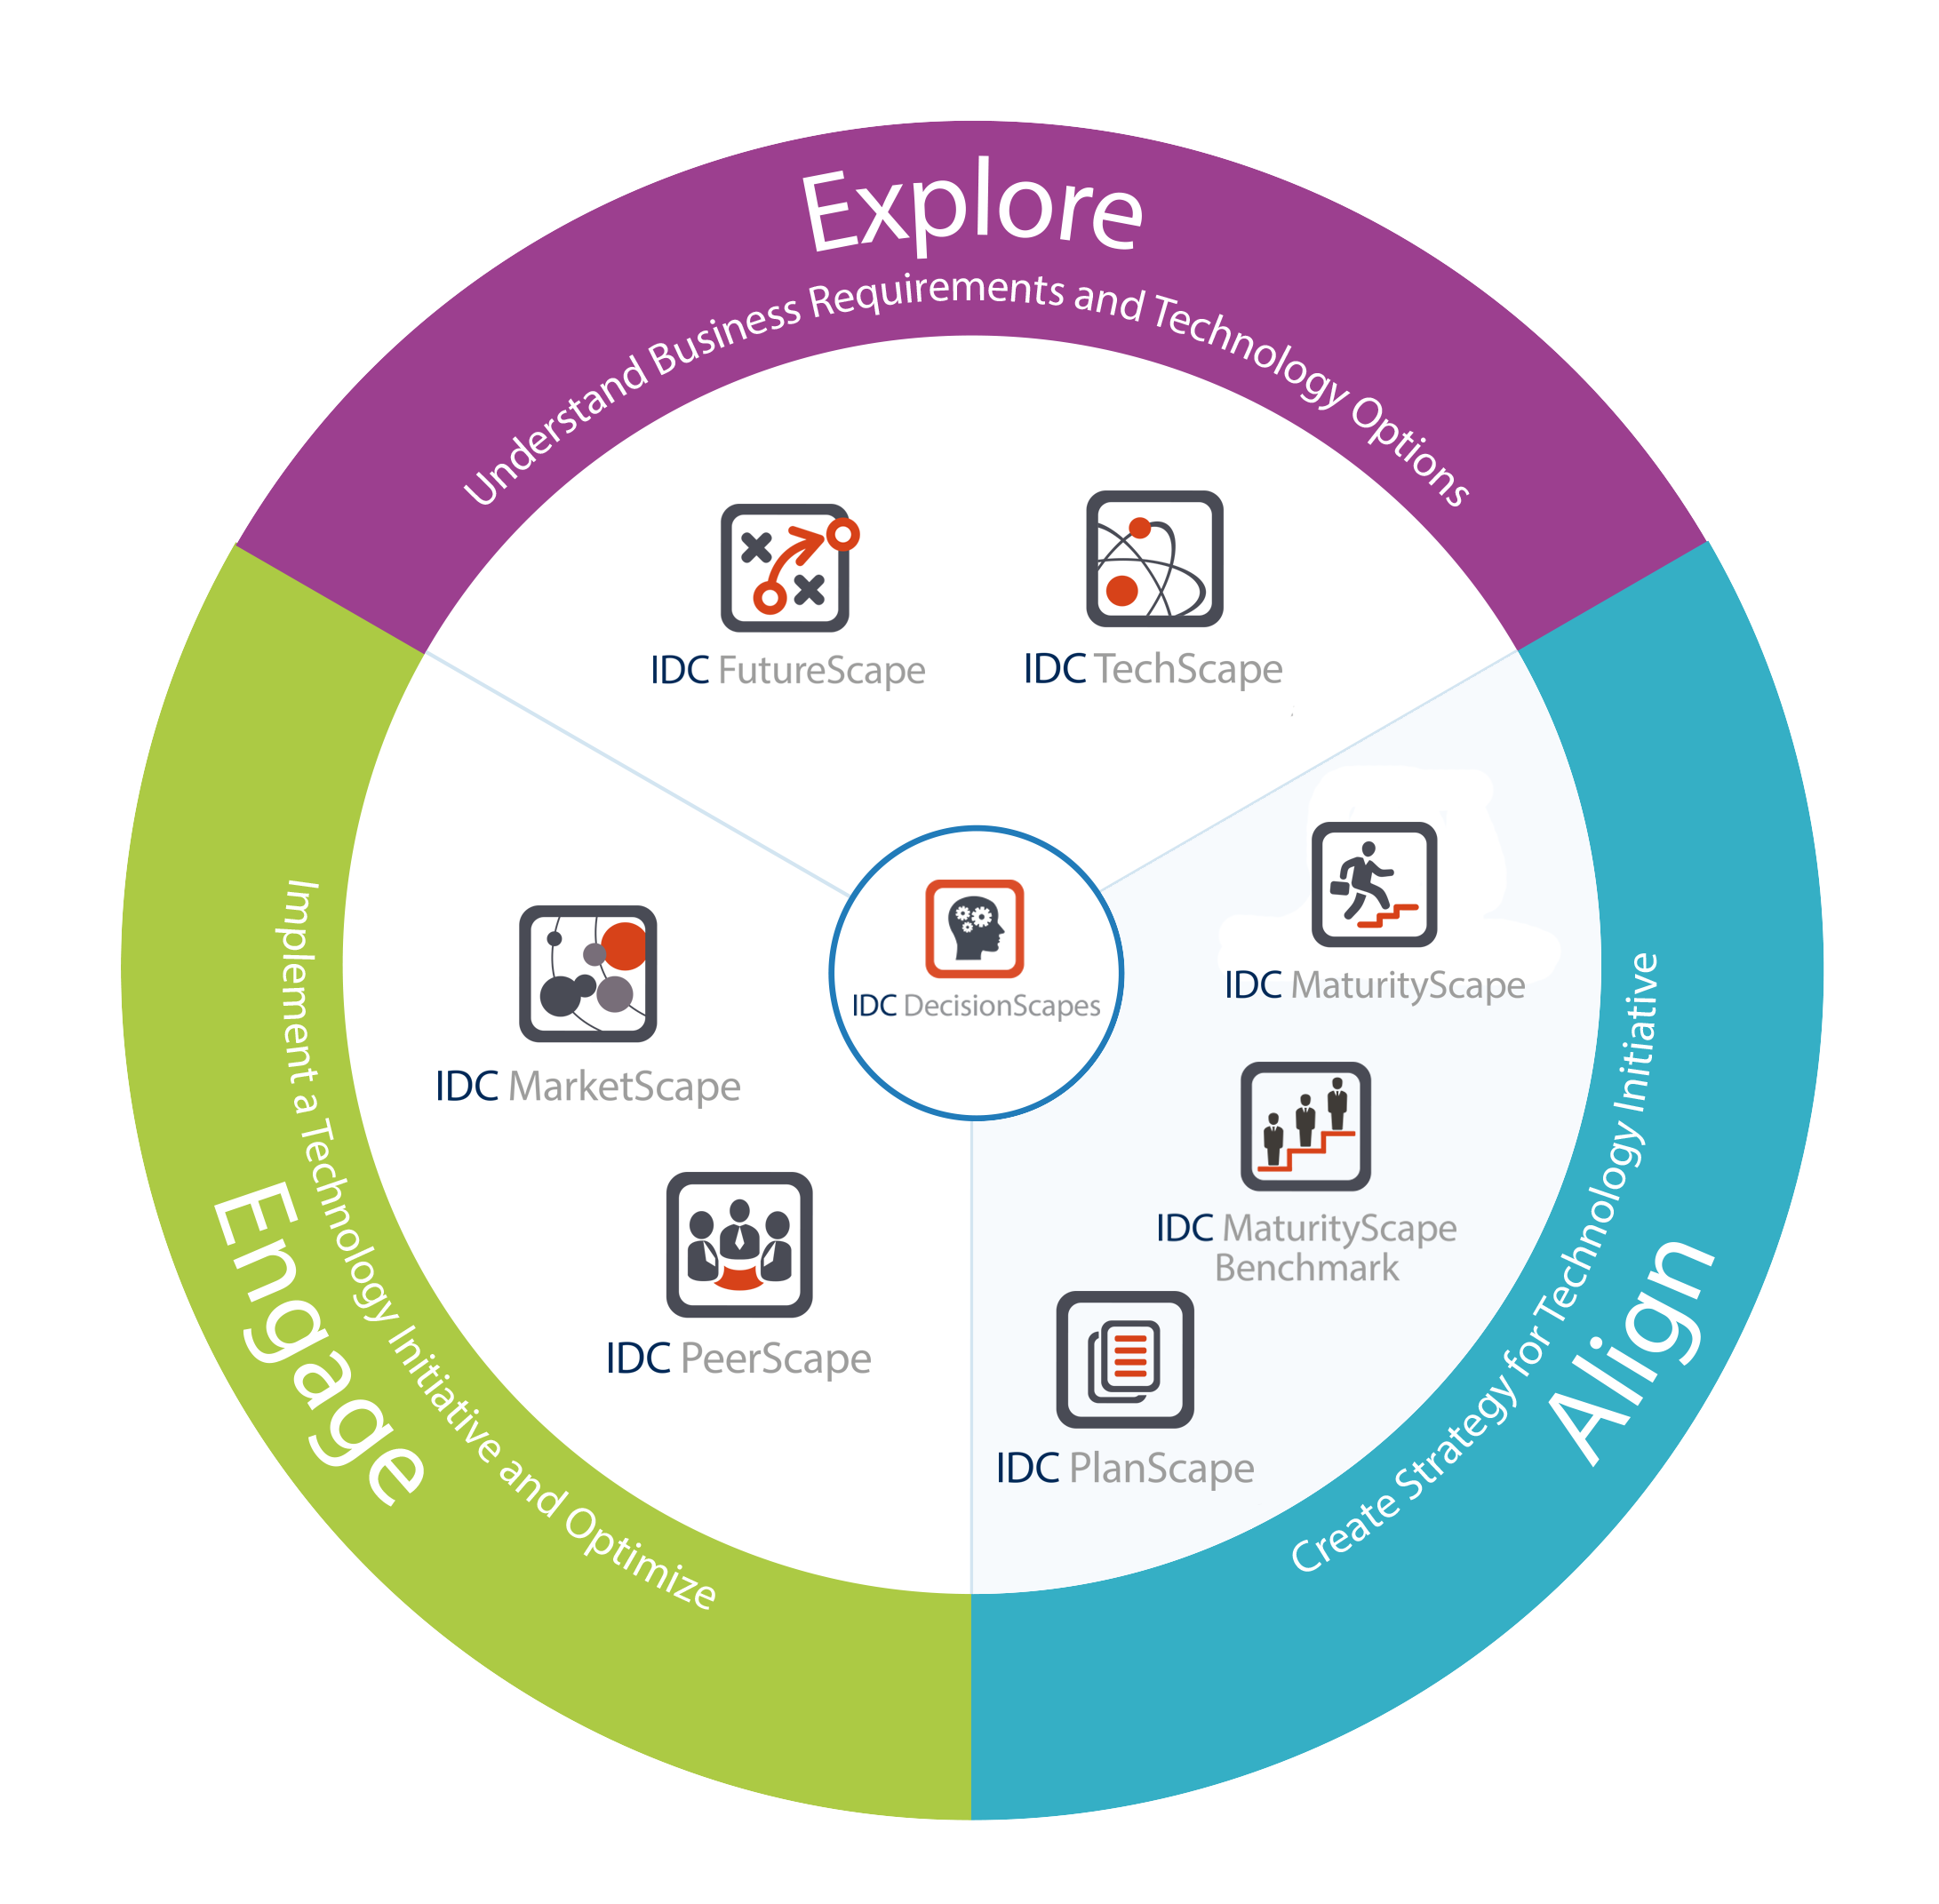


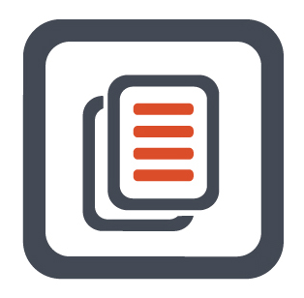
Align: Create a Strategy for a Technology Initiative
IDC MaturityScape provides a structured way to identify current levels of maturity, and the gap between where an organization is and where it needs to be to maintain competitive balance or achieve industry superiority.
IDC MaturityScape Benchmark enables organizations to compare maturity against peers, pinpoint where peers are more advanced, and identify the benefits achieved as one moves to more advanced stages.
IDC PlanScape assure business value is recognized from technology by developing a technology initiative that is aligned with business goals, scoped to succeed, and properly resourced.

Slide 9

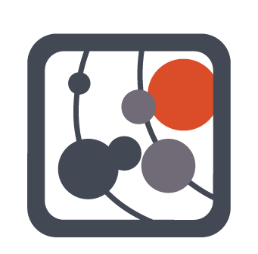
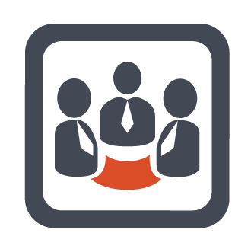
Engage: Launch Technology Initiative
IDC MarketScape mitigates supplier risk by providing an accurate and consistent assessment of suppliers’ characteristics, behavior and capabilities.
IDC PeerScape assures project success by identifying practices that have the most impact on the success of a technology initiative.

Slide 10
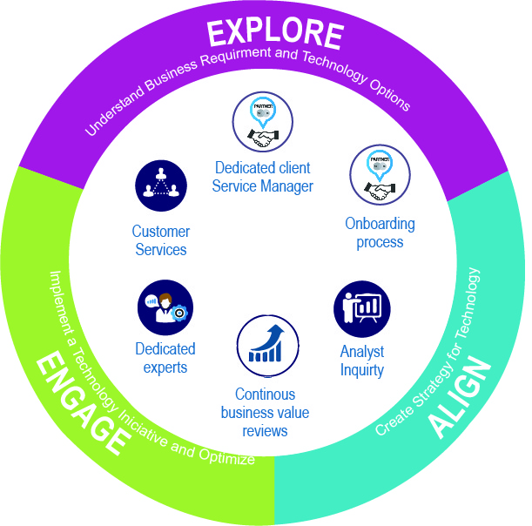


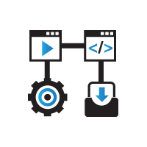


Analysts and sales partners who know your business objectives
C
Concierge Customer Service
A
B
C
Best in class concierge customer service: to help you make decisions faster -in local language-
Expert Analysts
Broad Base of Research
Concierge Customer Service
Zealous Customer Service
Dedicated client service manager who knows your business objectives
Onboarding process to identify your top priorities
Continuous business value reviews to ensure you are getting value from the relationship
Flexible support model, and customer service
Dedicated experts that sit on the research side of IDC, directly supporting our key clients

Slide 11
IDC is a great partner; they go above and
beyond. They are very proactive. The variation of information about the same topic, IDC MarketScapes, FutureScapes, and depth of resources on
a particular topic is very deep.
IT Executive
Major US Bank

Slide 12
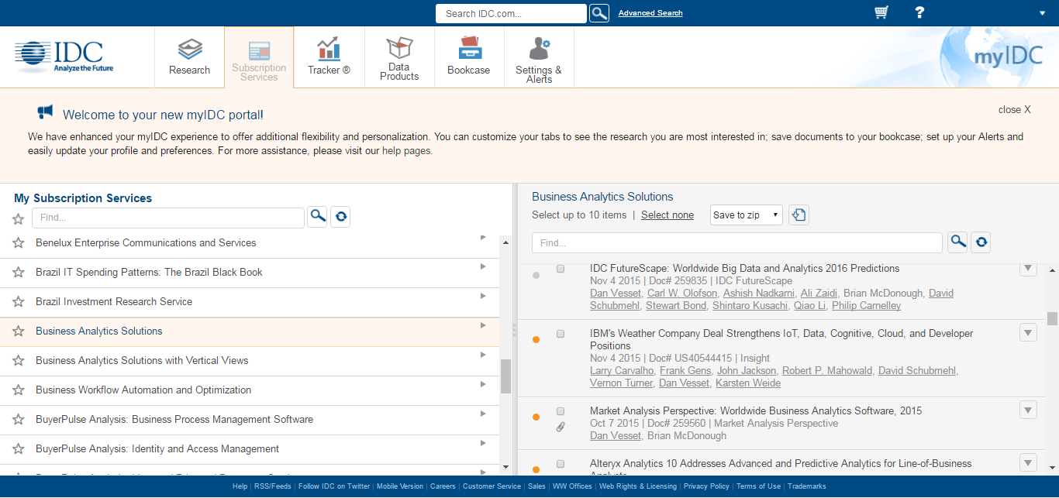
Direct Access to IDC’s research library
Dedicated client service manager who knows your business objectives
Onboarding process to identify your top priorities
Continuous business value reviews to ensure you are getting value from the relationship
Flexible support model, and customer service
Dedicated experts that sit on the research side of IDC, directly supporting our key clients

Slide 13



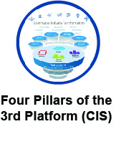

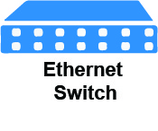


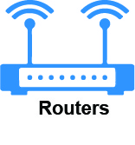






Technology Coverage Areas

Slide 14
Investment
Items | ITAP | GTAP
Open Access to IDC Worldwide Content: Open access to all horizontal worldwide IT content and global team of more than 1,100 analysts. | Yes | Yes
Open Access to IDC LA and Local Content: Open access to all horizontal regional and local IT content, and global team of more than 110 analysts | Yes | No
Open Access to IDC Insights Content: Open access to all industry-specific content* | Yes | No
Content Sharing: Licensees allowed to share IDC content among project teams | 2 | 2
Analyst Inquiry: 60 minute analyst calls and non-licensees are able to participate. Licensee is not required to be on the call. | unlimited calls | 10 calls
Engagement & Delivery: A dedicated Client Success Manager. This is a senior level position at IDC who is to be viewed as a proactive extension of your research staff. | Yes | Yes
Value Session: Every 3 months, IDC and your team meet to review key topics of focus. | Yes | Yes
On-Site Analyst Speaker: Vision Technology, put in the context of your organization | 2 Presentations | 1 Presentation
Free access to IDC Industry Events and Webinars: Invitation to IDC local events and online webinars | Yes | Yes
Subscription: 12-Month (USD) | 35,000 + Taxes | 20,000 + Taxes
Includes all IDC research on one of the following industries: Finance, Manufacturing, Government, Retail, Energy or Health. Excludes certain IDC/IDC insights products including: Trackers, Q Views, Forecasters, Market Share Guides, Spending Guides, IT Wallets, Multi-Client Studies, Special Reports, IDC Smart IT Tools, Blackbook Products, Private Vendor Watch, Executive Advisory Group Programs

