Slide 1
IDC Latin America Overview
October, 2017

Slide 2
IDC Offers Unmatched Global Presence
IDC is the main provider of market intelligence, advisory and event services for the ICT industry. We provide accurate insights, unbiased influence and actionable advice for technology buyers, technology suppliers and the investment community.
1,000+ analysts
covering trends in 110 Countries
Over 13,000
85,000+
IDC interactions
with Wall Street anually
client interactions
anually
Offices in over
50 Countries
10,000+ CIOs
300,000+
Influenced at IDC events
around the globe
end users surveyed anually
5,000+
Research Reports
published annually
3,000,000+
49%
End user impression per year (US)
of IDC analysts are in emerging markets

Slide 3
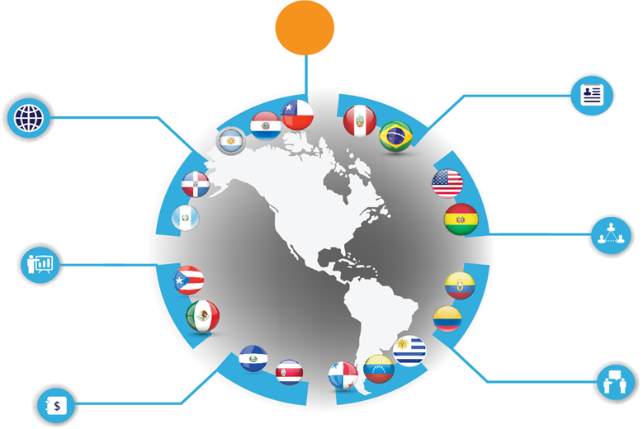
Comprehensive Knowledge of the Latin American ICT Market
101
Latin America based Research analysts
1,571
+18
Official vendor guidances received
Countries Covered
10k+
+535K
End-users surveyed
Import records captured
2900
+400K
Vendor and Channel interview conducted
Price points captured
IDC Latin America Market Methodology Highlights 2017

Slide 4
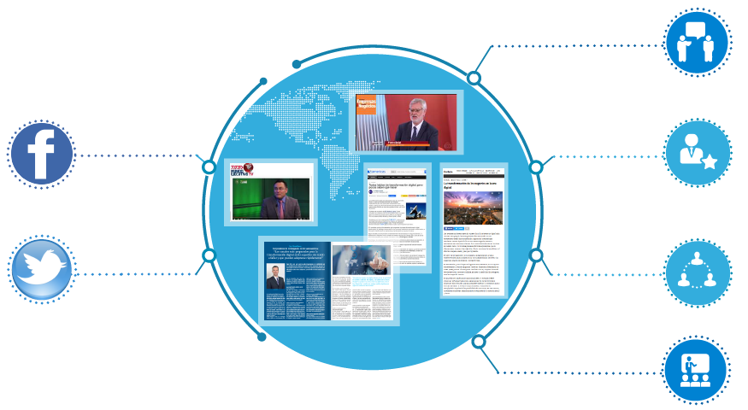
The Voice of the ICT Industry
Unbiased Authoritative Opinion Makes IDC The Voice of the ICT Industry in Latin America
330+
Press Interviews
1,700+
30k+
Likes on Facebook (SP+PO)
Media Mentions
7,700+
800+
Followers on Twitter (SP+PO)
IDC event attendees (Clients)
1200+
IDC event attendees (End Users)
IDC Latin America Market Highlights 2017

Slide 5
IDC Latin America’s Competitive Advantages
Presence
Accuracy
Opinion Leadership
Zealous Customer Service
25+ years of detailed market sizing and forecasting services for major countries in Latin America.
100+ analysts covering more than 20 countries and 100+ markets in the ICT industry every quarter.
Consistent methodologies across global markets to allow valid comparisons across countries, regions or the world.
Broad and deep coverage of thousands of direct sources in Latin America feed a best-in-class Big Data engine.
Years of experience curating information and pioneering data science.
Highest analyst to client ratio in the industry.
Most respected, frequently quoted source of global market intelligence.
First to market identifying disruptions: 3rd Platform; Digital Transformation (DX); IT 3D Leadership.
Flexible support model, and customer service.
Dedicated experts that sit on the research side of IDC, directly supporting our key clients.
Analysts and sales partners who know your business objectives.

Slide 6
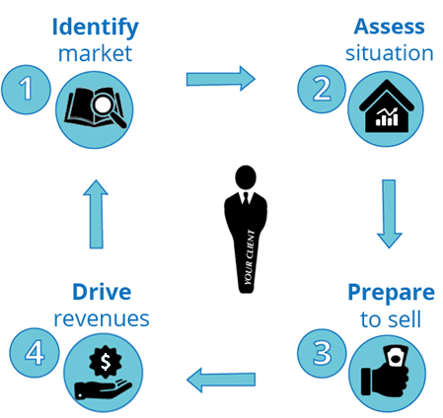
IDC can help you with your sales, marketing strategy & execution
Using its accurate research methodologies and thought leadership, IDC helps you to:
Solutions:
IDC Tracker® Products
IDC Spending Guides
Through:
Insight and influence programs aligned to your business goals
IDC Subscription Services
IDC Custom Solutions:
Integrated Marketing Programs
Marketing Planning & Operations
IDC Branded Events

Slide 7
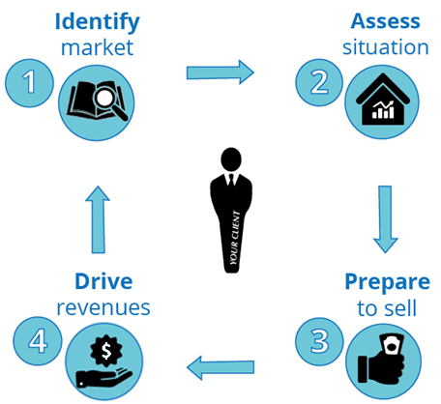
Who is the buyer persona?
Companies / Industries Growth Targets
Awareness / Competitors Partners / Sales Team
Increased Pipeline / Positioning Thought Leadership
Product / Influence Content Consultative Sales

Slide 8
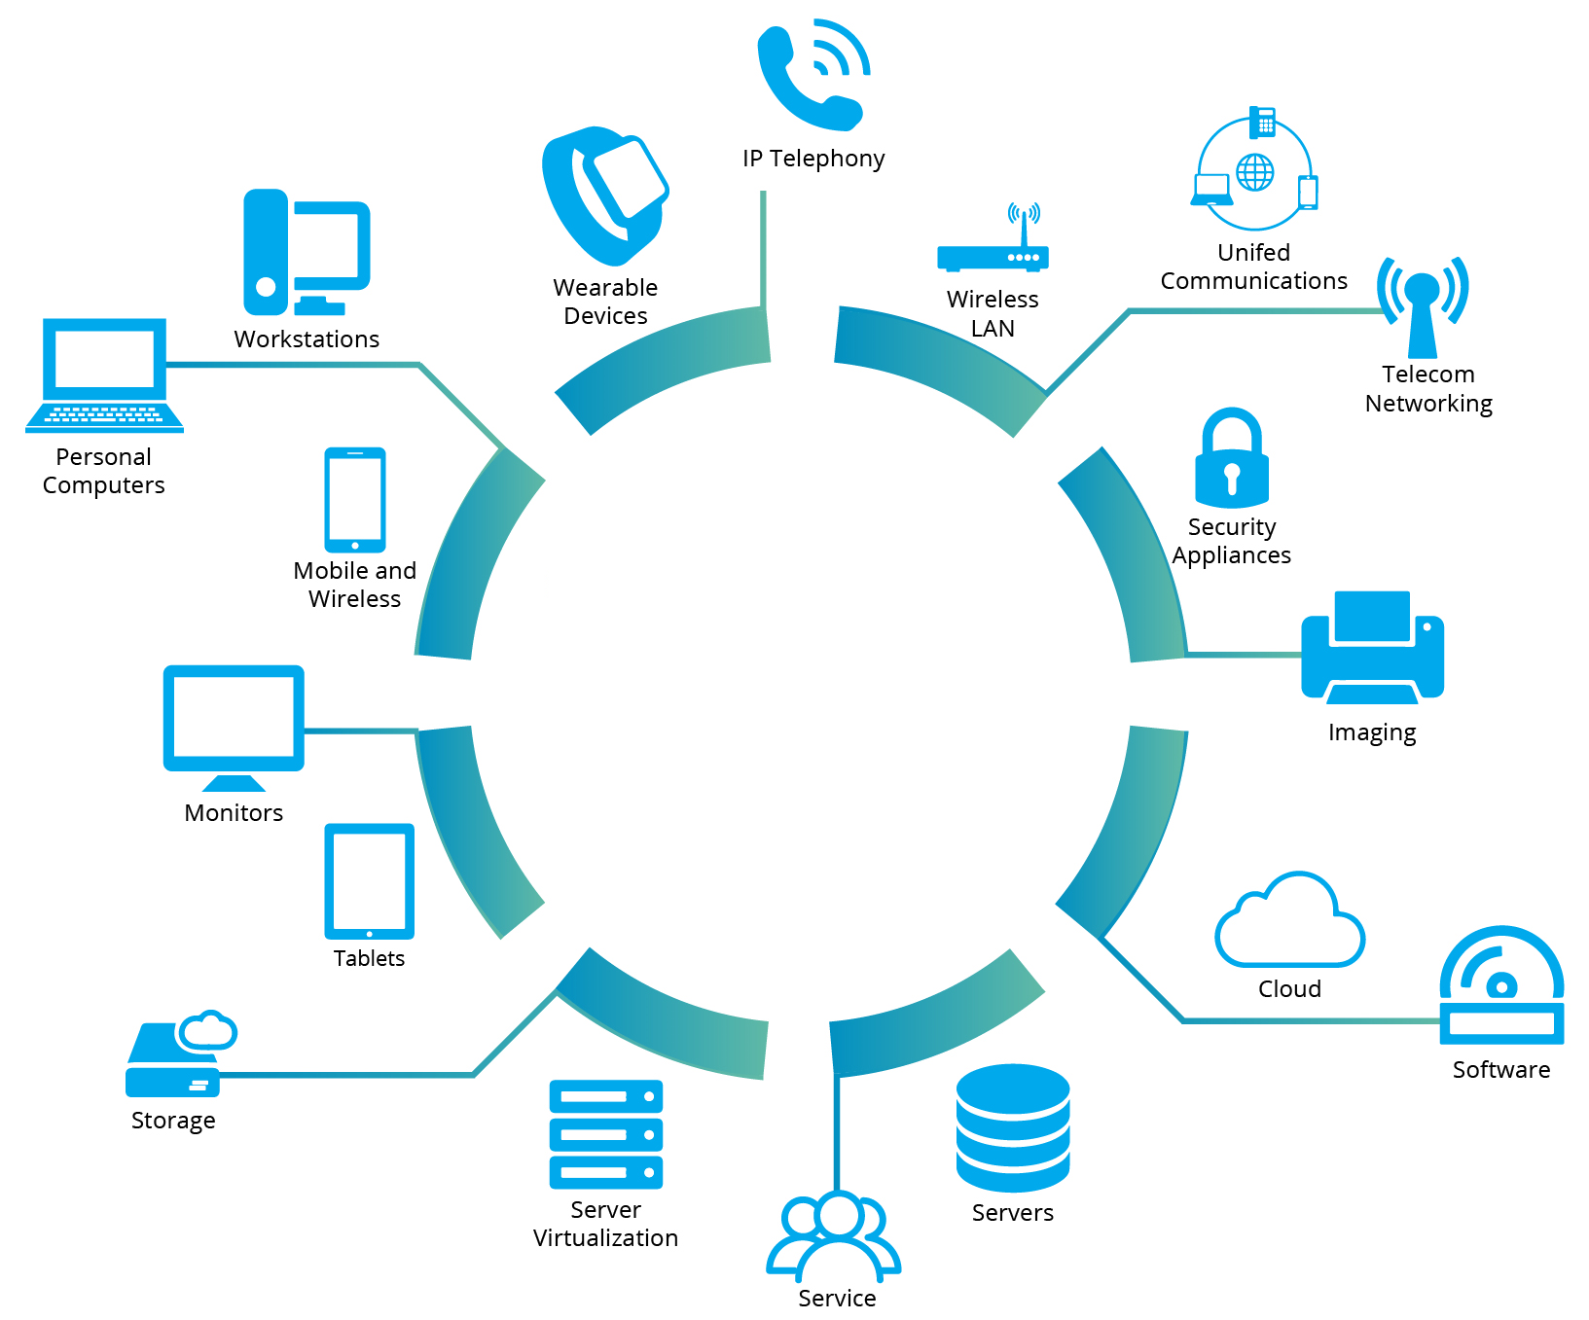
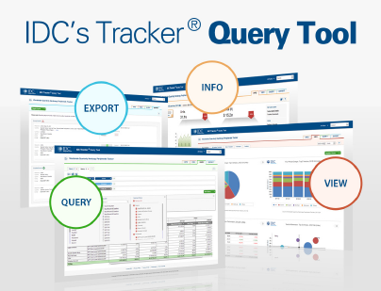
IDC Tracker ® Products
Providing accurate and timely market size, vendor share and forecasts for hundreds of technology markets -including emerging markets by city, state, and province- on a semiannual, quarterly or monthly basis.
I need to:
Support decisions in the planning and management of my businesses
Define my target market and right product mix
Understand competitive positioning
Monitor and measure my business performance
Anticipate and plan for changes in the market
Sample Coverage Areas:
Through:
User friendly excel deliverables and on-line web query tools
Notes:
Información precisa y oportuna en base semestral, trimestral o mensual sobre: tamaño del mercado, participación de los proveedores, forecast para la toma de decisiones.

Slide 9
IDC Spending Guides
Providing a global outlook on spending for IT vendors to develop effective market strategies. Strategic planners, market analysts and others seeking to understand the opportunities by industry will also benefit from these guides.
Core IT Spending Guides
I need to:
Develop effective market strategies, strategic planning and market analysis
Understand the opportunities by disruptive technologies
Identify products and services with likely higher demand
Understand the industries driving IT, 3rd Platform and Innovation accelerators regional spending
Identify market segments where my technology is seeing higher adoption rates
WW Semiannual IT Spending Guide: Industry & Company Size
8 regions / 53 countries
20 industries / 5 Co. Sizes
WW Semiannual IT Spending Guide: Line of Business
8 regions / 53 countries
19 industries / 5 Co. Sizes
WW Semiannual IT Spending Guide: SMB
8 regions / 53 countries
40 technologies / 4 co. sizes
3rd Platform Spending Guides
WW Semiannual Digital Transformation Spending Guide
2 regions
19 industries
5 DX markets
WW Semiannual Big Data & Analytics Spending Guide
8 regions / 53 countries
19 industries
5 co. sizes
WW Semiannual Mobility Spending Guide
8 regions / 53 countries
20 industries
5 co. sizes
WW Semiannual Public Cloud Spending Guide
8 regions / 47 countries
20 industries
5 co. sizes
Innovation Accelerator Spending Guides
WW Semiannual IoT Spending Guide
8 regions / 53 countries
14 industries
49 use cases
WW Semiannual Cognitive/ Artificial Intelligence Systems Spending Guide
8 regions
16 industries
22 use cases
WW Semiannual Security Spending Guide
8 regions / 47 countries
20 industries
5 co. sizes
WW Semiannual Commercial Robotics Spending Guide
8 regions
15 industries
52 use cases
WW Semiannual 3D Printing Spending Guide
8 regions
9 industries
15 use cases
WW Semiannual AR / VR Spending Guide
8 regions
10 industries
18 use cases

Slide 10
IDC Subscription Services
Continuous flow of data/information with the latest trends shaping the marketplace, the needs of IT decision makers, access to a comprehensive tool with services deals for lead generation and targeting opportunities across the region to better flourish in fast growing areas.
I need to:
Evaluate my opportunities in the region
Understand the impact of the latest trends in the Latin American ICT Market
Find emerging market opportunities
Develop services offerings for specific trends / industries
Increase my own coverage of deal activity
Understand key competitors in target accounts
Track major contracts and understand risk factors associated with renewals
Oct
Nov
Dec
Jan
Feb
Mar
Apr
May
Jun
Jul
Aug
Sep
CIS: Latin America Vertical Industry Transformation
Digital Disruption in the Utilities Sector
Healthcare Industry Transformation
Industry Clouds
Banking Transformation
Next Gen Telco Transformation
CIS: Latin America Internet of Things (IoT) and Smart Industries
IoT enabled Smart Cities in LA
IoT enabled Manufacturing and Robotics in LA
IoT enabled Agribusiness in LA
IoT enabled Transportation in LA
Latin America Digital Supply Chain
CIS: Impact of Cloud and Service Provider Trends in Latin America
Everything-as-a-service & the impact to vendors, channel partners, customers
Cloud’s Long Tail: Telcos, cloud marketplaces and cloud brokers
Service Provider CAPEX trends in Latin America
IaaS and PaaS Trends in Latin America
Software Defined Everything and NFV
Contract Database: BuyerPulse Database
Annual subscription or data cut - Tool updated in real time with the most recent findings for each country.

Slide 11
IDC Custom Solutions: Integrated Marketing Programs (IMP)
Developing and delivering programs designed around your specific business goals using a foundation of research, insights across technologies, geographies and industries that span strategy, sales and marketing, and business measurement and management.
Thought Leadership and Content Development
Developing compelling and relevant content, to be used in multiple sales and marketing campaigns. IDC’s experts collaborate with you to build and deliver messaging, assets and tactics that support your goals.
I need to:
Develop relevant, impactful marketing messages and campaigns to engage my audience
Support sales throughout the customer buying cycle
Grow the business via insights into brand, product, and customers.
Effectively launch new products / campaigns
Identify potential business opportunities
Shorten the sales cycle
Business Value Tools
Create powerful online lead-generation tools and financial justifications for IT solution purchases. Engage with prospects and improve the sales team’s speech, quickening conversion rates, and increasing revenue.
Sales Advisory
IDC combines its in-depth knowledge of how ICT products/services are both sold and bought in the region; the unique understanding of ICT investments and top companies’ needs to empower your sales teams.
Audience Development and Vendor Events Support
Strengthen your event and reinforce your recruiting activities before your event, and help your sales team open doors with potential clients.
Account Prospecting
Use of IDC’s studies and analyst Insight to discover clusters of companies that represent the best opportunity for you. Contact info of selected profiles in the companies is obtained by IDC’s Call Center.

Slide 12
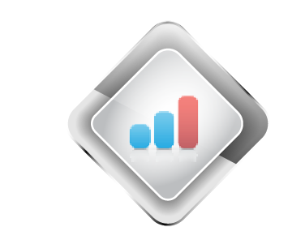
IDC Custom Solutions: Marketing Planning & Operations
Developing and delivering programs designed around your specific business goals using a foundation of research, insights across technologies, geographies and industries that span strategy, sales and marketing, and business measurement and management.
I need to:
Build successful business strategies
Make informed decisions for planning and budgeting
Support sales throughout the customer buying cycle
Grow the business via insights into brand, product, and customers.
Identify potential business opportunities
Shorten the sales cycle
Provide actionable partner intelligence
Custom Analytics
Get a single source of market intelligence that helps you speed your decision making process, strategically allocate money and resources and plan for market entry or expansion.
Buyer Behavior
Get actionable insight and recommendations for business and consumer technology decision makers to help make more informed product development, marketing decisions and increase market share.
Channel and Partnering
Providing actionable partner intelligence and tools to help you to design, develop and manage successful partnering programs; maximizing the return of your partnering investment.

Slide 13
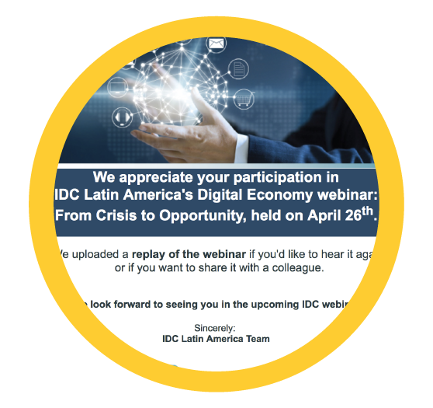
IDC Branded Events
Providing ICT vendors with invaluable face time with targeted senior technologists and business decision makers responsible for influencing, evaluating, and purchasing technology solutions and products through exceptional and valuable experiences.
I need to:
Build dynamic and profitable business relationships.
Create valuable relationships and reduce sales cycles
Engage additional prospects for my event
Focus on targeted accounts and sectors
Give my audience leading perspectives, analysis, and data on the hottest technology, services, and business issues from a trusted third-party source.
IDC Industry Events
IDC industry conferences and road-shows attract thousands of senior ICT decision-makers annually to network and discuss key ICT issues, providing your sales team an excellent opportunity to expand your contact network and discover new leads.
IDC Webinars
Online seminars to a broad audience of ICT influencers and decision makers across multiple geographies. Audio replay campaign to promote the recorded content and obtain additional registrants, increasing the ROI of the online event.
IDC Round Tables
IDC-branded, invitation-only, event that bring 10-15 top IT decision makers to market-level discussions with IDC and your executives. This small group format creates an open and intimate environment that fosters deep networking and allows participants to build closer relationships.

Slide 14
IDC can help you with your sales, marketing strategy & execution
Using its accurate research methodologies and thought leadership, IDC helps you to:
Tracker ®
Tracker ® by Month
Custom Analytics
Top Organizations Benchmark
IT Spending
Spending Guides
Strategic Market Assessment
Compete ®
Win/Loss Analysis
Channel and Partnering
Buyer Behavior
Strategic Market Assessment
CIS
Contract Database
Companies / Industries Growth Targets
Awareness / Competitors Partners / Sales Team
Industry Conferences
Customized Events
Event Services
Audience Development
IDC Speakers
Sales Advisory
Content Development
Business Value
Channel and Partnering
CXO Sales Effectiveness
Honorarium
IDC Reports
Increased Pipeline / Positioning Thought Leadership
Product / Influence Content Consultative Sales

