Slide 1
IDC LA Custom Solutions: Integrated Marketing Programs (IMP)
Value Proposition

Slide 2
IDC Offers Unmatched Global Presence
IDC is the main provider of market intelligence, advisory and event services for the ICT industry. We provide accurate insights, unbiased influence and actionable advice for technology buyers, technology suppliers and the investment community.
1,000+ analysts
covering trends in 110 Countries
Over 13,000
85,000+
IDC interactions
with Wall Street anually
client interactions
anually
Offices in over
50 Countries
10,000+ CIOs
300,000+
Influenced at IDC events
around the globe
end users surveyed anually
5,000+
Research Reports
published annually
3,000,000+
49%
End user impression per year (US)
of IDC analysts are in emerging markets

Slide 3
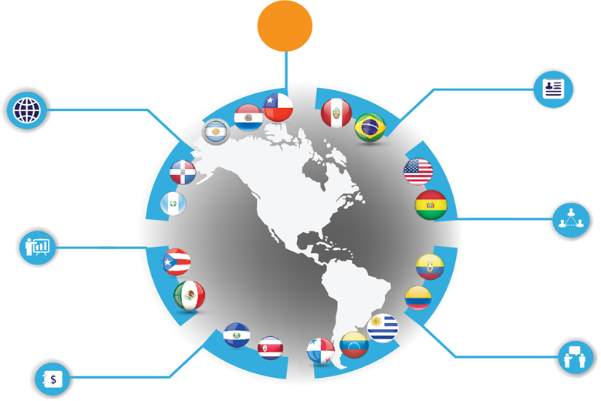
Comprehensive Knowledge of the Latin American ICT Market
81
Latin America based Research analysts
1,455
18
Official vendor guidances received
Countries Covered
8k+
492K
End-users surveyed
Import records captured
2675
392K
Vendor and Channel interview conducted
Price points captured
IDC Latin America Market Methodology Highlights 2016

Slide 4
The Voice of the ICT Industry
Unbiased Authoritative Opinion Makes IDC The Voice of the ICT Industry in Latin America
293
Press Interviews
1600+
24k+
Likes on Facebook (SP+PO)
Media Mentions
7000+
1200+
Followers on Twitter (SP+PO)
IDC event attendees
IDC Latin America Market Highlights 2016

Slide 5
IDC Latin America’s Competitive Advantages
Presence
Accuracy
Opinion Leadership
Zealous Customer Service
25+ years of detailed market sizing and forecasting services for major countries in Latin America.
80+ analysts covering more than 20 countries and 100+ markets in the ICT industry every quarter.
Consistent methodologies across global markets to allow valid comparisons across countries, regions or the world.
Broad and deep coverage of thousands of direct sources in Latin America feed a best-in-class Big Data engine.
Years of experience curating information and pioneering data science.
Highest analyst to client ratio in the industry.
Most respected, frequently quoted source of global market intelligence.
First to market identifying disruptions: 3rd Platform; Digital Transformation (DX); IT 3D Leadership.
Flexible support model, and customer service.
Dedicated experts that sit on the research side of IDC, directly supporting our key clients.
Analysts and sales partners who know your business objectives.

Slide 6
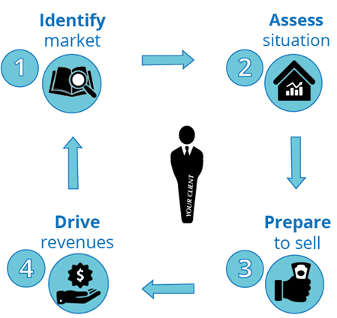
IDC can help you with your sales, marketing strategy & execution
Using its accurate research methodologies and thought leadership, IDC helps you to:
Solutions:
IDC Tracker® Products
IDC Spending Guides
Through:
Insight and influence programs aligned to your business goals
IDC Subscription Services
IDC Custom Solutions:
Integrated Marketing Programs
Marketing Planning & Operations
IDC Branded Events

Slide 7
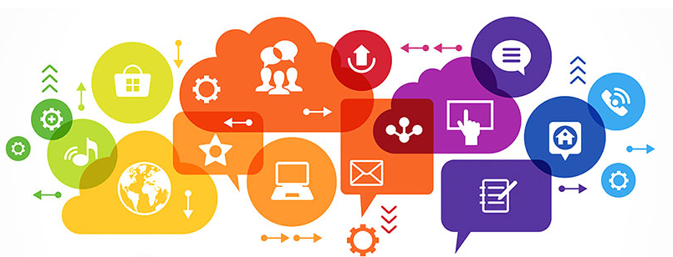
Do you know that…
Buyers are 57% of the way down the sales path by the time they engage with YOUR website?
Blow up the funnel: Buyers access digital information and listen to peers throughout their decision-journey?
71% of customers who ended a business relationship did so because of a poor customer service experience?
Sources: IDC’s U.S. 2017 Small & Mid-sized Business annual survey Jan 2017, N=800 / Forbes

Slide 8
How to be more effective?
By thoughtfully generating and curating focused, informative content, you can guide and support potential clients through their buyer’s journey, and develop an engaged and loyal customer base.
IDC Customer Experience Loop
E v a l u a t e
R e n e w
Purchase
Advocate
E x p l o r e
E x p a n d
Creation Loop
Loyalty Loop

Slide 9
Exploration Stage
IDC Customer Experience Loop
E v a l u a t e
R e n e w
Purchase
Advocate
Prospects seek to fit a solution to a business challenge. Could include lowering cost, raising capacity/ productivity, responding to competitive threat
E x p l o r e
E x p a n d
Creation Loop
Loyalty Loop
Help your customer:
Reflect upon a situation of unbalance
Describe his/her needs in the form of exploration criteria
Search and sort information about potential solutions
How:
Provide information on related trends
Explain why these trends are relevant to the situation
Ask and respond questions that they never even thought
Demonstrate that peers have similar needs
Through:
Thought Leadership and Content Development
Analyst Connection / Executive Brief / White Paper
InfoBrief / Infographic / Interactive Infographic
Videographic / Video Insight / Hot Site
Business Value Tools
Auto Assessment Tool
Audience Development and Events
Speaker On Site / Presentation Plus /Email Blast Campaign / Event Guidance / Audio Replay
Round Tables / Industry Events / Webinars

Slide 10
Evaluate Stage
IDC Customer Experience Loop
E v a l u a t e
R e n e w
Purchase
Advocate
Prospects validate and compare vendor claims through demos, references, product trials
E x p l o r e
E x p a n d
Creation Loop
Loyalty Loop
Help your customer:
Classify solution requirements
Rank attributes against business outcomes
Benchmark and define a roadmap
Identify potential solution providers
Outline a buying approach
How:
Demonstrate your understanding of core business issues
Showcase your solution against business outcomes
Map a solution journey
Show examples of success
Position your strenghts in the marketplace
Through:
Thought Leadership and Content Development
Executive Brief /Vendor Spotlight /Case Study /White Paper
InfoBrief / Hot Site
Business Value Tools
Auto Assessment Tool / End User DX Workshop
Audience Development and Events
Speaker On Site / Presentation Plus /Email Blast Campaign / Event Guidance / Audio Replay
Round Tables / Industry Events / Webinars
Sales Advisory
CXO Sales Effectiveness
Account Prospecting

Slide 11
Purchase Stage
IDC Customer Experience Loop
E v a l u a t e
R e n e w
Purchase
Advocate
Prospects commit to deploying the solution and negotiate terms and conditions
E x p l o r e
E x p a n d
Creation Loop
Loyalty Loop
Help your customer:
Identify provider options
Classify and compare value of solutions
Reach agreements between technical and business buyers
Justify the correct decision
How:
Use executive references
Connect the technology and the business outcomes stories
Use the correct channel and message for each buying persona
Demonstrate the benefits of existing implementations
Through:
Thought Leadership and Content Development
Vendor Spotlight / Case Study / White Paper
Video Insight / Hot Site
Business Value Tools
Auto Assessment Tool / End User DX Workshop
Sales Advisory
CXO Sales Effectiveness

Slide 12
Expand Stage
IDC Customer Experience Loop
E v a l u a t e
R e n e w
Purchase
Advocate
Customers master the solution and may expand use by adding users and functionality
E x p l o r e
E x p a n d
Creation Loop
Loyalty Loop
Help your customer:
Compare success of implementation against buying criteria
Evolve and expand realized value
Move along the maturity roadmap
How:
Analyze the win/loss situation
Monitor current and next steps in the DX roadmap
Through:
Thought Leadership and Content Development
Executive Brief / White Paper / InfoBrief
Video Insight
Business Value Tools
Auto Assessment Tool / End User DX Workshop / Client Council Workshop
Audience Development and Events
Speaker On Site/ Event Guidance / Audio Replay
Round Tables
Sales Advisory
Win and Loss Analysis

Slide 13
Renew Stage
IDC Customer Experience Loop
E v a l u a t e
R e n e w
Purchase
Advocate
Customers review their satisfaction with the solution and provider, assess performance and potential, decide whether to continue the relationship
E x p l o r e
E x p a n d
Creation Loop
Loyalty Loop
Help your customer:
Articulate concrete benefits that justify renewal
Express the value gaps early on
How:
Build a constructive feedback process
Delineate accurate metrics of success/opportunity
Through:
Business Value Tools
Client Council Workshop
Sales Advisory
Win and Loss Analysis

Slide 14
Advocate Stage
IDC Customer Experience Loop
E v a l u a t e
R e n e w
Purchase
Advocate
Customers develop a strategic partnership with the supplier, become a reference account, and actively promote their success
E x p l o r e
E x p a n d
Creation Loop
Loyalty Loop
Help your customer:
Become a reference
Explain the success factors
Close value gaps via constructive feedback
How:
Share valuable insights from lessons learned
Showcase their accomplishments against your brand value
Demonstrate the strategic consequences of the partnership
Through:
Thought Leadership and Content Development
Case Study
Business Value Tools
Client Council Workshop
Sales Advisory
Win and Loss Analysis

Slide 15
IDC Custom Solutions: Integrated Marketing Programs (IMP)
Developing and delivering programs designed around your specific business goals using a foundation of research, insights across technologies, geographies and industries that span strategy, sales and marketing, and business measurement and management.
Thought Leadership and Content Development
Developing compelling and relevant content, to be used in multiple sales and marketing campaigns. IDC’s experts collaborate with you to build and deliver messaging, assets and tactics that support your goals.
I need to:
Develop relevant, impactful marketing messages and campaigns to engage my audience
Support sales throughout the customer buying cycle
Grow the business via insights into brand, product, and customers.
Effectively launch new products / campaigns
Identify potential business opportunities
Shorten the sales cycle
Business Value Tools
Create powerful online lead-generation tools and financial justifications for IT solution purchases. Engage with prospects and improve the sales team’s speech, quickening conversion rates, and increasing revenue.
Sales Advisory
IDC combines its in-depth knowledge of how ICT products/services are both sold and bought in the region; the unique understanding of ICT investments and top companies’ needs to empower your sales teams.
Account Prospecting
Use of IDC’s studies and analyst Insight to discover clusters of companies that represent the best opportunity for you. Contact info of selected profiles in the companies is obtained by IDC’s Call Center.
Audience Development and Vendor Events Support
Strengthen your event and reinforce your recruiting activities before your event, and help your sales team open doors with potential clients.
Audience Development and IDC’s Branded Events
Invaluable time with targeted senior technologists and business decision makers responsible for influencing, evaluating and purchasing technology solutions through exceptional and valuable experiences doors with potential clients.

Slide 16
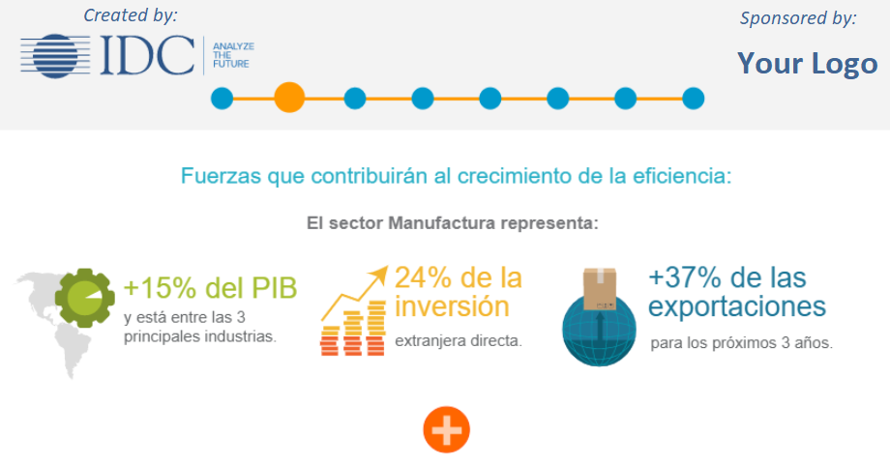
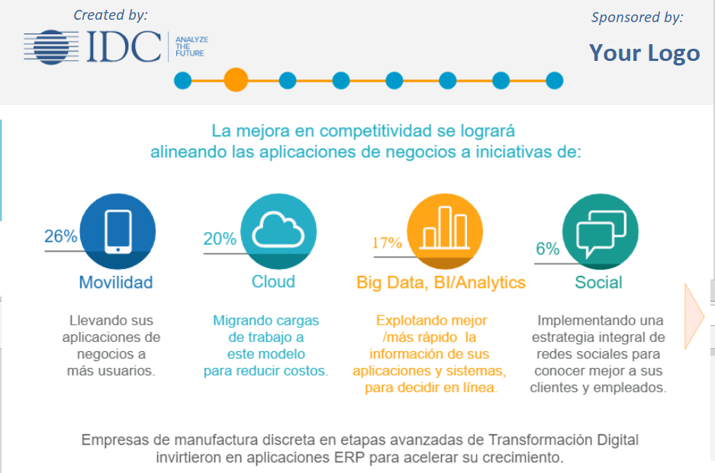
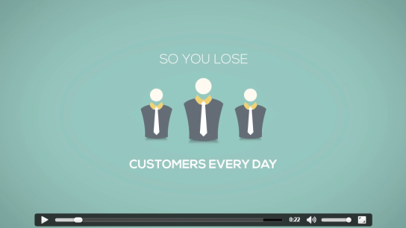
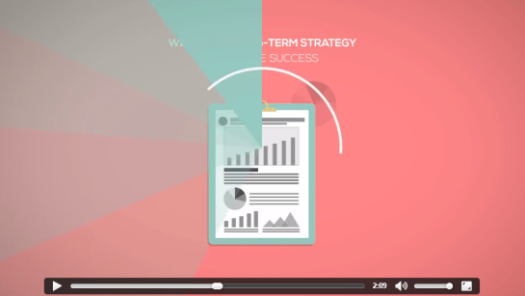
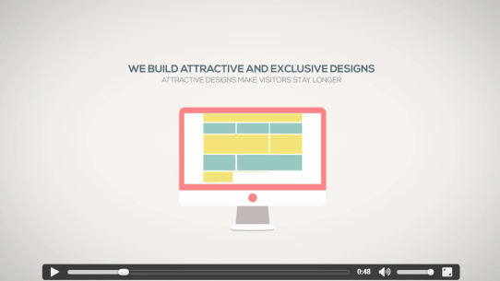
IDC Custom Solutions: Integrated Marketing Programs (IMP)
Developing and delivering programs designed around your specific business goals using a foundation of research, insights across technologies, geographies and industries that span strategy, sales and marketing, and business measurement and management.
Thought Leadership and Content Development
Analyst Connection
Executive Brief
Vendor Spotlight
Case Study
White Paper
Info Brief
Q&A-paper with IDC analyst responses to end-user questions.
Market-leveIl discussions providing DC thought leadership and quantitative insights.
Insights on a market trend followed by vendor’s offering and how is responding to buyers needs.
Independent third-party point of view of end user adoption of a solution to that provide real-world proofbeen your solutions has successfully implemented.
Primary research-based document provides insightful, in-depth analysis of key trends and/or vendor's strategy and offerings.
Engaging visual document providing IDC thought leadership and quantitative insights to improve campaign results.
Infographic
Interactive
Infographic
Videographic
Video Insight
Hot Site
Market overview in quick-reference story and graphic format to capture instant attention from the audience.
Animated 2 minute video about a market and/or technology trend in an easy to understand video-story.
Video clip produced by IDC featuring an IDC analyst presenting key trends and data.
Campaign hub with engaging information for maximizing traffic flow results.
Powerful visual stories related to a market overview in an interactive and intuitive form.

Slide 17
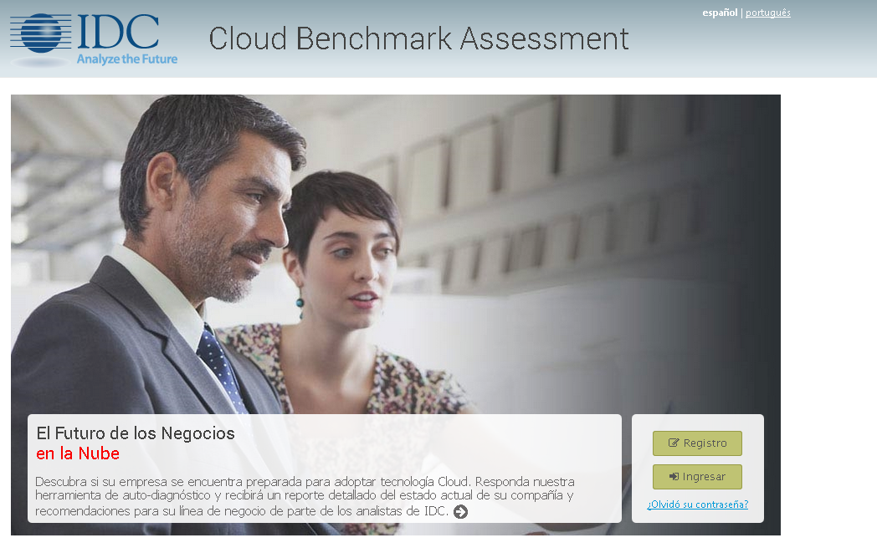
IDC Custom Solutions: Integrated Marketing Programs (IMP)
Developing and delivering programs designed around your specific business goals using a foundation of research, insights across technologies, geographies and industries that span strategy, sales and marketing, and business measurement and management.
Business Value Tools
Auto Assessment Tool
End User DX Workshop
Client Council Workshop
Interactive workshop that engages all stakeholders in an End User (Purchaser of IT) into the discussion of DX. Very useful to reach the End User and to “elevate” the conversation with top clients.
Workshop with your clients in order to understand their main needs and challenges related to your services/products through an interactive tool.
Interactive tool designed to engage the prospect in the exploration and evaluation stages of the buying cycle.
Sales Advisory
Account Prospecting
CXO Sales Effectiveness
Win/Loss Analysis
Account Prospecting
IDC’s interviews to specific companies related to recent projects that your company has won or lost in order to identify the key elements of the purchase decision criteria in selecting a specific product / services.
Discover clusters of companies that represent the best opportunity for an ITC Vendor. Contact info of selected profiles in the companies belonging to these clusters is obtained by IDC’s Call Center (service provided by a business partner).
Comprehensive workshop helps your sales team improve business-outcome, audience-driven sales performance.

Slide 18
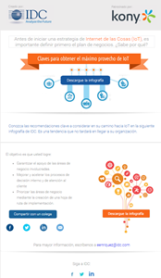
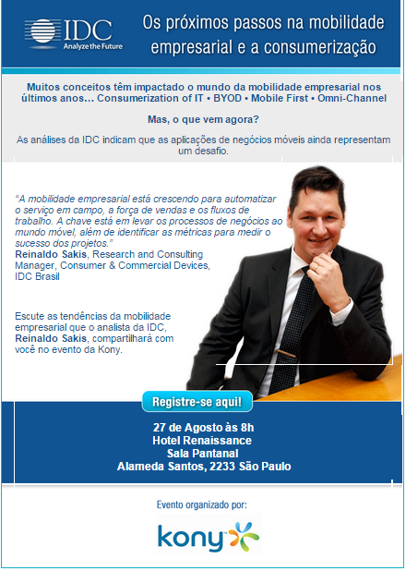
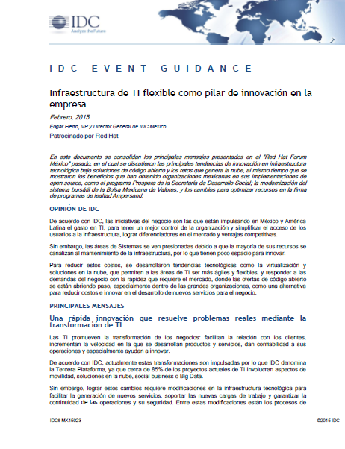
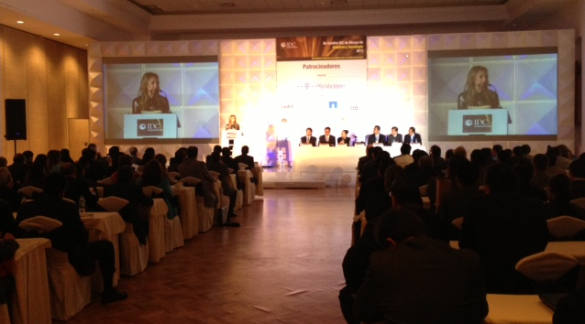
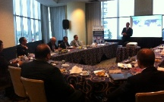
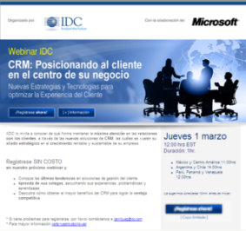
IDC Custom Solutions: Integrated Marketing Programs (IMP)
Developing and delivering programs designed around your specific business goals using a foundation of research, insights across technologies, geographies and industries that span strategy, sales and marketing, and business measurement and management.
Audience Development and Events: Vendor Events Support
Email Blast
Campaign
Presentation Plus
Speaker On Site
Event Guidance
Audio Replay
An email blast to a defined target within our database promoting IDC analyst participation in your event. You will also have the right to use IDC’s logo on any event marketing collateral.
Experienced, engaging IDC analysts deliver keynote or market overviews, facilitate roundtable discussions, or participate in panel discussions in-person in your event.
IDC-branded document, written by the IDC analysts who was the key note speaker at the event, summarizing the highlights and discussion points raised by attendees during the event.
IDC produces an articulated presentation slide deck, with the same presentation given during the event, so that you can share with those who missed your event.
Customized content developed by IDC and delivered to a target audience eliciting a call to action to generate leads for a campaign or an event.
Audience Development and Events: IDC’s Branded Events
IDC Industry Event
IDC Round Table
IDC Webinar
IDC industry conferences and road-shows attract hundreds of senior ICT decision-makers to network and discuss Key ICT issues, providing you an excellent opportunity to network.
Small IDC-branded, invitation-only, event for 10-15 top IT decision makers. Agenda around market-level discussions with IDC and your executives.
Online seminar by an IDC expert, via an interactive conferencing platform across multiple geographies. Content is recorded and made available after the web event.

